Slide 1

Password generator
Done by:
S.Hitesh Kumaar
1931011

Slide 2
ABSTRACT:
The task is to generate a random password that may consist of alphabets, numbers, and special characters.
This is implemeted using HTML,CSS and JAVA SCRIPT

Slide 3
HTML:
The Hyper Text Markup Language, or HTML is the standard markup language for documents designed to be displayed in a web browser.
CSS:
Cascading Style Sheets is a style sheet language used for describing the presentation of a document written in a markup language such as HTML.
JS:
javascript (JS) is a scripting languages, primarily used on the Web. It is used to enhance HTML pages and is commonly found embedded in HTML code.

Slide 4
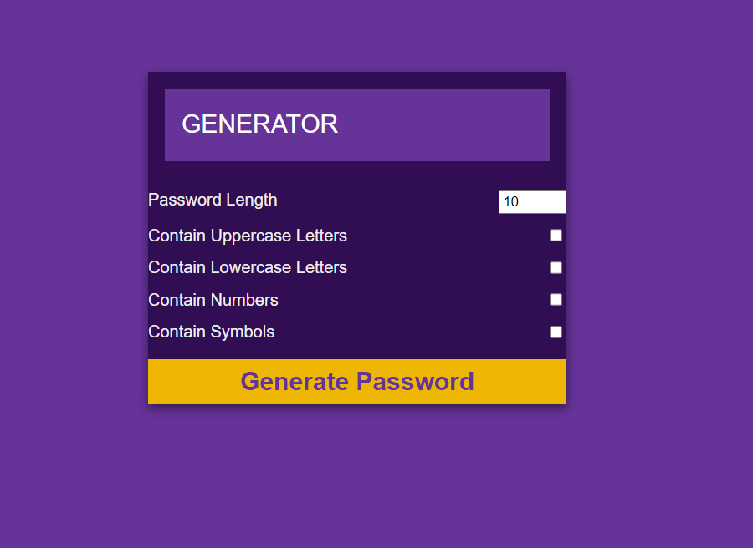
HTML PAGE:

Slide 5
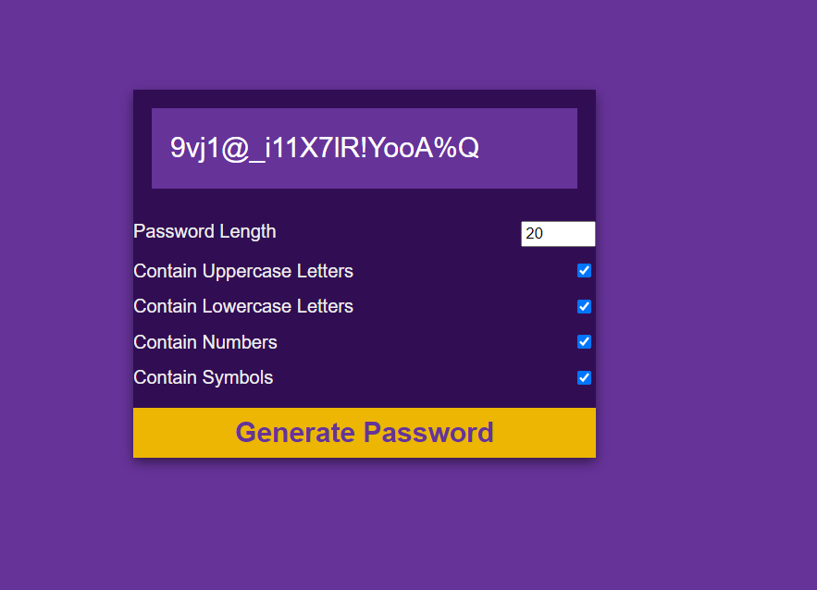
OUTPUT:

Slide 6
THANK YOU!

